Slide 1

Capstone Project Presentation
CSA0307- Data Structures
HealthTrace: Smart Disease Contact Tracing Using Graph Data Structures
Guided by
Dr. Kiruthika K
Presented by
192511093- R. Janani Sri
192511316- K. Divya
192521457- S. Thanishka

Slide 2



ABSTRACT
Disease outbreaks spread rapidly through human interactions, making it difficult to identify infected individuals.
Traditional contact tracing methods are often manual, time-consuming, and prone to errors.
This project proposes a graph-based contact tracing system where individuals are represented as nodes and their interactions as edges.
The proposed approach enables faster, more accurate, and scalable contact tracing and control disease spread effectively.

Slide 3

INTRODUCTION
Disease outbreaks such as COVID-19 have highlighted the importance of efficient contact tracing.
Traditional methods rely on interviews and manual record-keeping, which can be slow and inaccurate.
Graph data structures provide an effective way to model social interactions, where people are represented as nodes and their contacts as edges.
By traversing the graph, healthcare professionals can quickly trace the chain of infection and identify individuals at risk.
This project improves disease monitoring, reduce transmission, and assist public health decision-making.

Slide 4

PROBLEM STATEMENT
Existing Issues:
Current contact tracing systems are mostly manual, making them slow, labor-intensive, and less effective for large populations.
Delays in identifying infected individuals and their contacts can lead to rapid disease transmission..
Proposed Solution:
There is a need for an automated, graph-based system that efficiently stores contact relationships and quickly identifies potential disease exposure using graph traversal techniques.

Slide 5
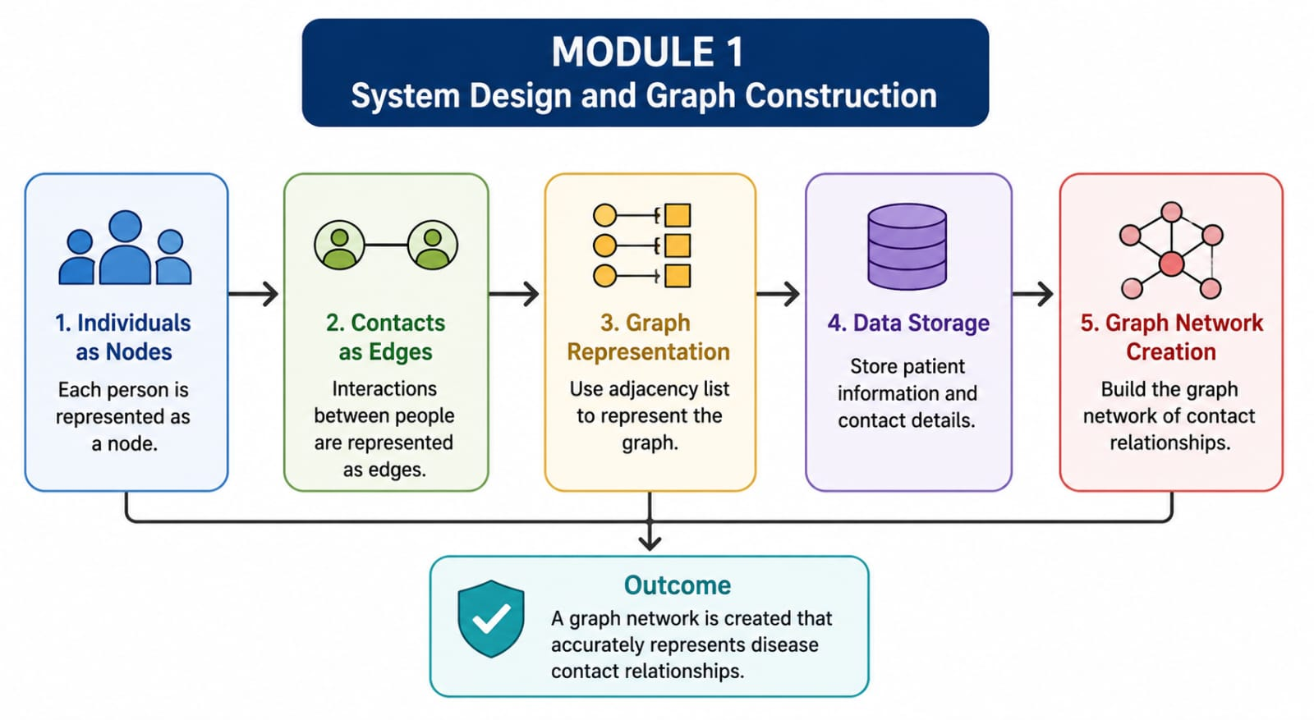
Module 1: System Design and Graph Construction

Slide 6
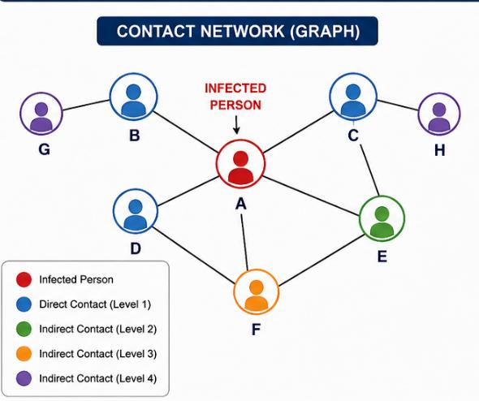
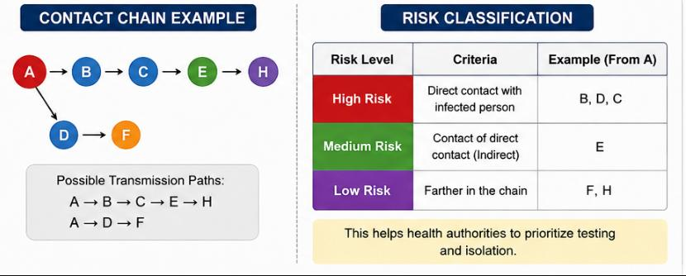
Module 2: Contact Tracing Using Graph Algorithms
Objective:
To identify infected contacts using graph traversal algorithms.
Contents:
Breadth-First Search (BFS)
Depth-First Search (DFS)
Direct Contact Identification
Indirect Contact Identification
Contact Chain Analysis
Risk Classification (High, Medium, Low)
Outcome:
The system efficiently traces disease transmission paths and identifies individuals at risk.

Slide 7
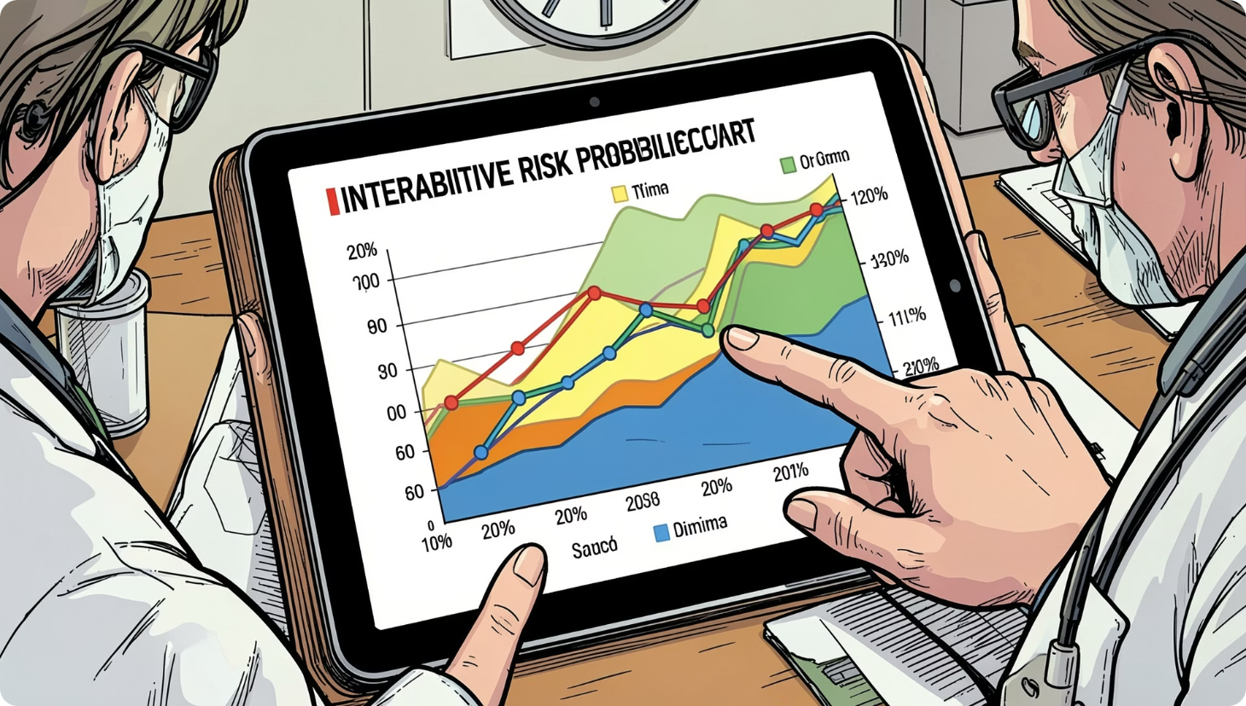
Module 3: Disease Monitoring and Reporting
Objective
To generate useful insights for healthcare authorities.
Contents
Infection Spread Visualization
Hotspot Detection
Contact History Report
Risk Alert Generation
Statistical Summary
Healthcare Decision Support
Outcome
The system provides visual reports and alerts that support quick decision-making and disease control.

Slide 8
IMPLEMENTATION

Slide 9
OUTPUT

Slide 10

CONCLUSION
The proposed graph-based disease contact tracing system provides an efficient solution for identifying disease transmission paths.
By using graph data structures and traversal algorithms, the system quickly identifies direct and indirect contacts of infected individuals.
Compared to manual methods, it offers faster processing, improved accuracy
Better scalability, enabling healthcare organizations to respond more effectively during disease outbreaks.

Slide 11


FUTURE SCOPE
Integration with AI for disease spread prediction.
Real-time contact tracing using GPS and IoT devices.
Mobile application for instant exposure notifications.
Cloud-based storage for large-scale healthcare systems.
Heat map generation for outbreak visualization.
Integration with hospital information systems.
Privacy-preserving contact tracing using blockchain.
Predictive analytics for future outbreak prevention.
10

Slide 12
REFERENCES
1. D. C. Chan, P. K. Pollett, and M. C. Weinstein, "Quantitative Risk Stratification in Markov Chains with Limiting Conditional Distributions," Medical Decision Making, vol. 29, no. 4, pp. 532–540, 2009.
2. Sage JournalsN. J. Welton and A. E. Ades, "Estimation of Markov Chain Transition Probabilities and Rates from Fully and Partially Observed Data: Uncertainty Propagation, Evidence Synthesis, and Model Calibration," Medical Decision Making, vol. 25, no. 6, pp. 633–645, 2005.
3. Sage JournalsB. M. Eskofier and J. Klucken, "Predictive Models for Health Deterioration: Understanding Disease Pathways for Personalized Medicine," Annual Review of Biomedical Engineering, vol. 25, pp. 131–156, 2023.
4. Annual ReviewsC. C. Bennett and K. Hauser, "Artificial Intelligence Framework for Simulating Clinical Decision-Making: A Markov Decision Process Approach," 2013.
5. arXivT. Pham, T. Tran, D. Phung, and S. Venkatesh, "DeepCare: A Deep Dynamic Memory Model for Predictive Medicine," 2016.
12

Slide 13
THANK YOU
13

